Slide 1
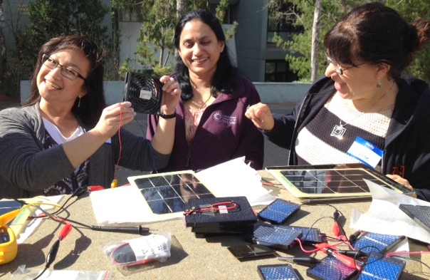
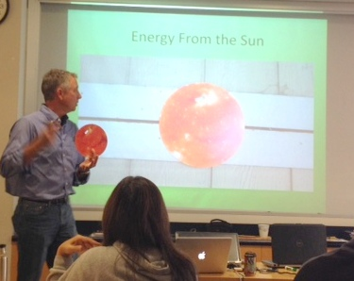
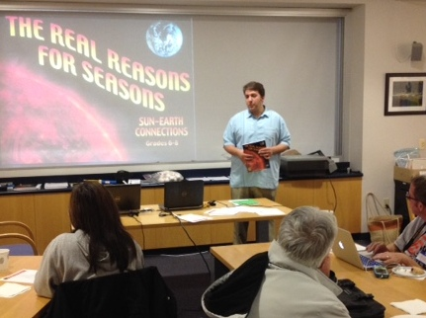
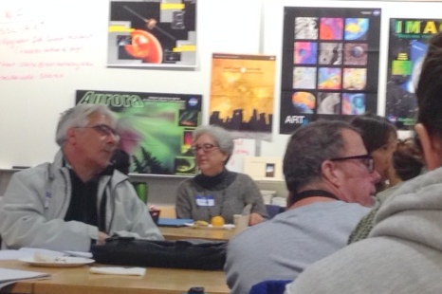
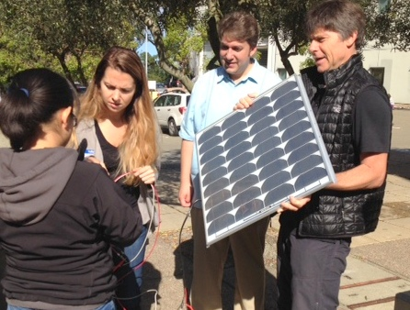
Energy from the Sun in Space and on Earth
(ESSE) Fall Teacher Workshops, Berkeley
The Energy from the Sun team successfully completed another two-day educator workshop at the Space Sciences Lab, UC Berkeley. With our solar energy partner, Dr. Hal Aronson (We Care Solar), we trained 25 elementary, middle and high school educators who worked with a wide range of NASA’s heliophysics resources as well as curricula on solar energy.
We had the pleasure of having two former workshop participants present what they have been implementing at their school sites—it is impressive work indeed! One teacher has integrated our solar topics monthly starting in September and ending in June and the other is not only developing solar-related programing at his middle school, but at neighboring elementary and high school sites too.
Teachers have found the combination of topics to be a winning one—allowing them to integrate the science of the Sun with engineering, passive solar and photovoltaics.
We will meet again with this group of educators in early in 2015 to learn how they have implemented the material in their classroom practice.
Teachers from past workshops
return to share implementation
Strategies with colleagues
Using solar cells to experiment with circuitry, changing angles and
modules of various sizes
Delving into cutting-edge
NASA science and core
concepts about the Sun
Learning about seasons to make
connections with passive solar
design concepts
A few teachers comments on the October and November Workshops—
“This workshop reinforces my previous lessons around the Sun—Great to have the hands-on experience in the workshop.”
“I will use Eye on the Sky majorly in constructing an NGSS-aligned unit on astronomy. Thank-you! This was extraordinarily high quality training and truly fun!! Activities are easy to follow”
“Thank you! Bryan, Claire and Ruth were an amazing invaluable resource.” “This was one of the best workshops I’ve taken in a long time. Thank you!”
“I like how some misconceptions in science have been addressed and clarified. Very valuable.” “Great presentations! I will be able to teach students right away with what I obtained—knowledge and materials.”
‘Thank you for making this applicable to all grade levels. My students love science and the interactive nature of the activities can foster vocab development, literacy, writing etc.” For more information, contact Ruth Paglierani, ruthp@ssl.berkeley.edu
1

